Slide 1
server main: chatRoom.server.ServerChat.java
client main: chatRoom.client.ClientChat.java
enjoy with some bugs

Slide 2
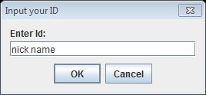
Set Nickname

Slide 3
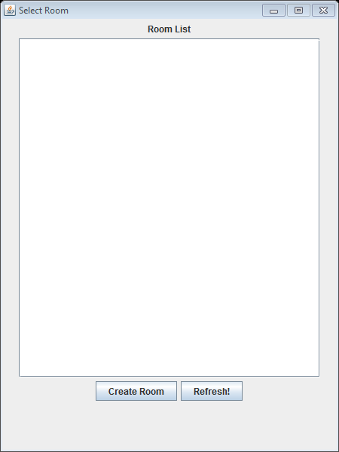
Room List

Slide 4
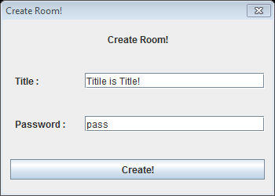
Set Title
password (option!)

Slide 5
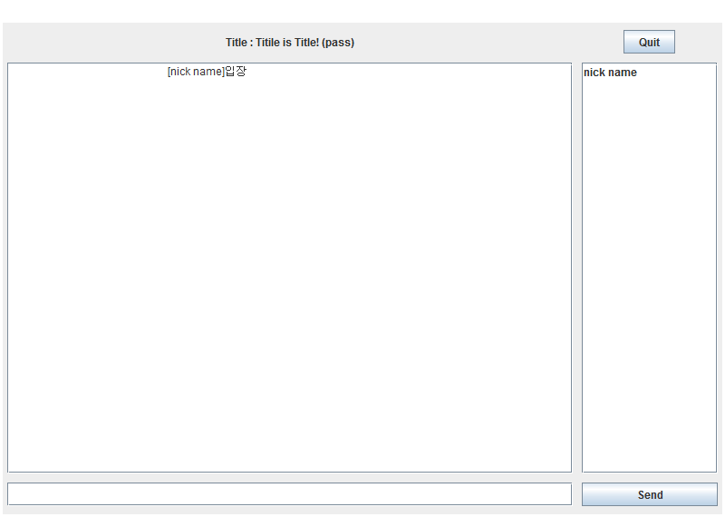
enjoy chat

Slide 6
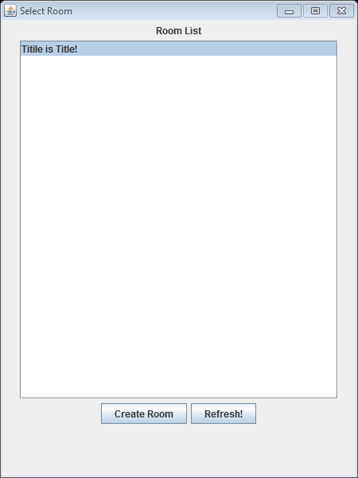
select exist
chat room

Slide 7
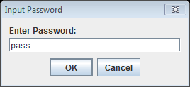
put password when it is exist

Slide 8
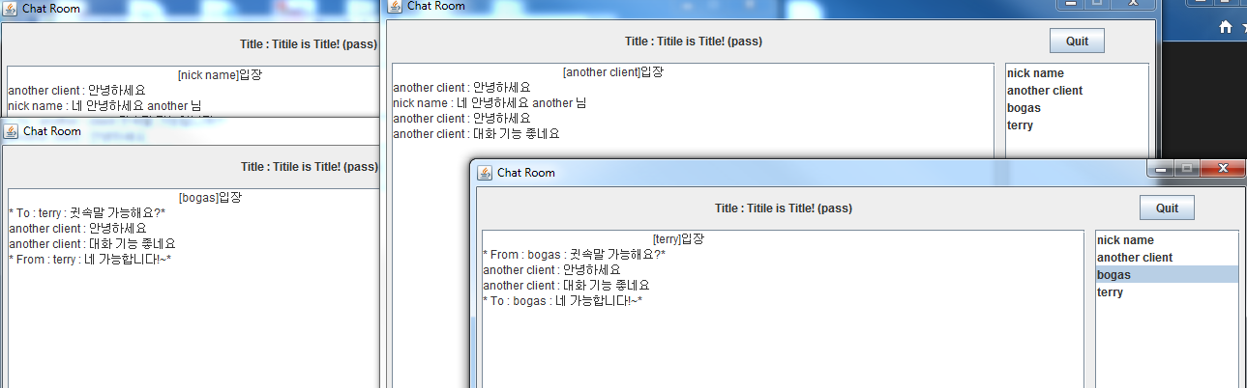
enjoy chat with whisper feature!

